Slide 1
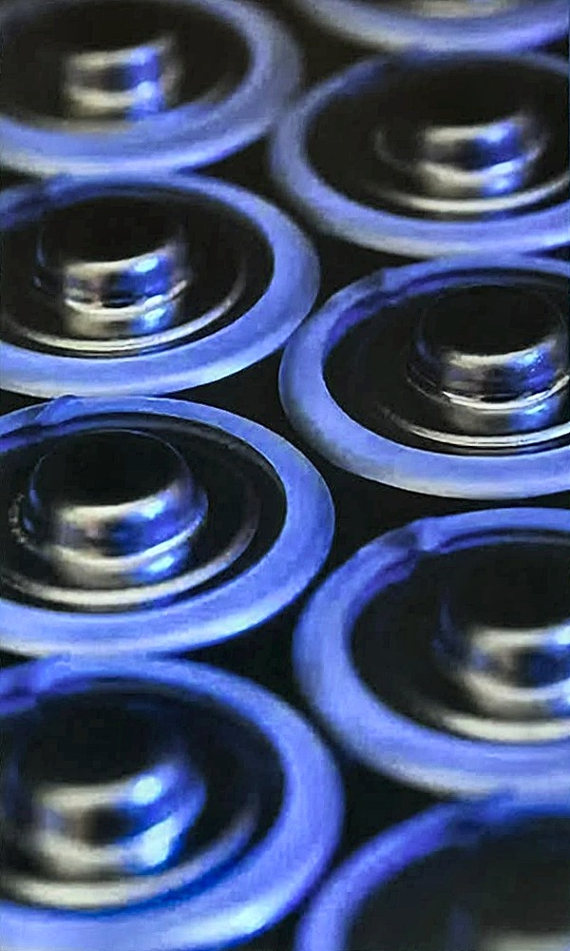
OVERVIEW
Context: EV market, critical raw materials, batteries
Industry & policy: supply chain, recycling capacity, EU legislation
Circular strategies: remanufacturing, repurposing, recycling, Battery Passport
Research & methods: objectives, dynamic MFA, scenarios
Results & conclusion: material flows, circular flows, sensitivity

Slide 2
SECTION 1 / 5 · CONTEXT
WHY IS THIS TOPIC RELEVANT
The Automotive sector employs 13.8 million people and contributes to 7% of the EU’s GDP

Slide 3
SECTION 1 / 5 · CONTEXT
INDUSTRIAL CONTEXT
BEV reached 17.4% of EU-27 new car registrations in 2025 (1.88 million cars), up from 13.6% in 2024. Hybrids led at 34.5%, ahead of petrol at 26.6%; PHEV 9.4%, diesel 8.9%.
Source: ACEA (2026)

Slide 4
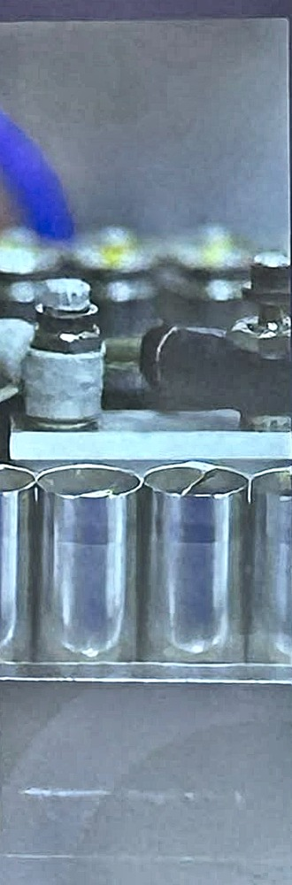
SECTION 1 / 5 · CONTEXT
THE CHALLENGE
Resource Dependency
Environmental Impact
End of Life Management
The production of LIBs relies heavily on critical raw materials (CRMs) which are often sourced from and processed in geopolitically sensitive regions.
The extraction and processing of these materials are energy-intensive and environmentally harmful, contributing to CO2 emissions and environmental degradation.
EoL batteries pose significant challenges in terms of safe disposal, recycling efficiency, and the recovery of valuable materials.

Slide 5
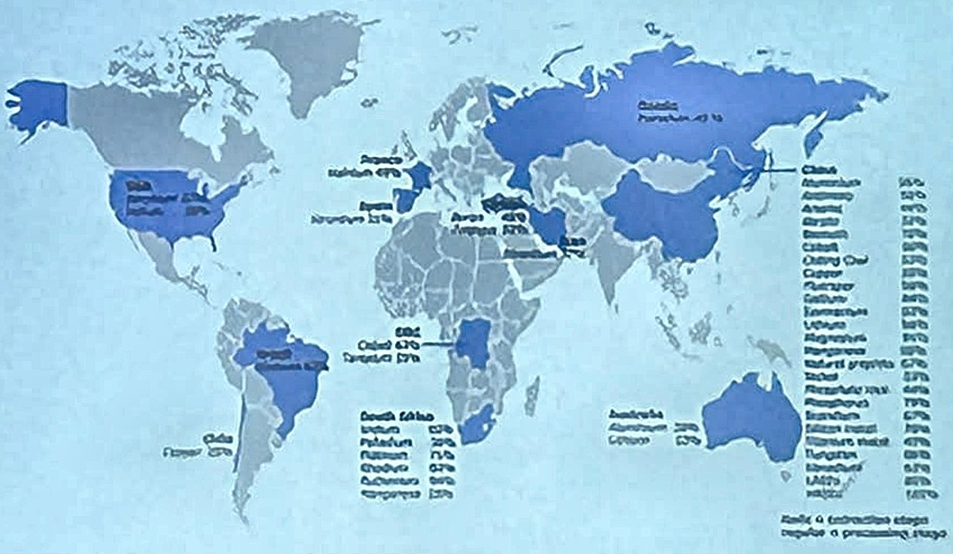
SECTION 1 / 5 · CONTEXT
Critical Raw
Materials
Study on the Critical Raw Materials for the EU
2023
Objective:
Economic Importance (EI)
Supply Risk (SR)
A material is considered Critical when it meets or exceeds the established thresholds:
EI ≥ 2.8 and SR ≥ 1.0
Final Report

Slide 6
SECTION 1 / 5 · CONTEXT
Critical Raw
Materials
Table 1: List of materials/groupings covered in the 2023 assessment
Individual materials
Aggregates | Helium | Rhenium
Aluminium/bauxite | Hydrogen | Scandium
Antimony | Indium | Selenium
Arsenic | Iron Ore | Sulphur
Baryte | Krypton | Potash
Bentonite | Lead | Silica Sand
Beryllium | Limestone | Silicon Metal
Bismuth | Gold | Silver
Boron | Gypsum | Strontium
Cadmium | Lithium | Talc
Chromium | Magnesite | Tantalum
Kaolin clay | Magnesium | Tellurium
Cobalt | Manganese | Tin
Coking coal | Molybdenum | Titanium
Copper | Natural Graphite | Tungsten
Diatomite | Neon | Vanadium
Feldspar | Nickel | Xenon
Fluorspar | Niobium | Zinc
Gallium | Perlite | Zirconium
Germanium | Phosphorus | Titanium metal
Hafnium | Phosphate rock
Platinum group metals (PGMs)
Iridium | Platinum | Ruthenium
Palladium | Rhodium
Rare earth elements (REEs)
LREEs | HREEs
Cerium | Dysprosium | Lutetium
Lanthanum | Erbium | Terbium
Neodymium | Europium | Thulium
Praseodymium | Gadolinium | Ytterbium
Samarium | Holmium | Yttrium
Biotic materials
Natural Rubber | Natural cork | Roundwood
Sapele wood | Natural Teak wood
Legend:
Green boxes | Materials covered in 2014 assessment but not in 2011
Orange boxes | Materials covered in 2017 but not in 2014
Light blue boxes | Materials covered in 2020 but not in 2017
Yellow boxes | Materials covered in 2023 but not in 2020
Objective:
Economic Importance (EI)
Supply Risk (SR)
A material is considered Critical when it meets or exceeds the established thresholds:
EI ≥ 2.8 and SR ≥ 1.0

Slide 7
SECTION 1 / 5 · CONTEXT
Critical Raw
Materials
Objective:
Material | EI | SR
Cobalt | 6,8 | 2,8
Lithium | 3,9 | 1,9
Nickel | 5,7 | 0,5
Economic Importance (EI)
Supply Risk (SR)
A material is considered Critical when it meets or exceeds the established thresholds:
EI ≥ 2.8 and SR ≥ 1.0

Slide 8
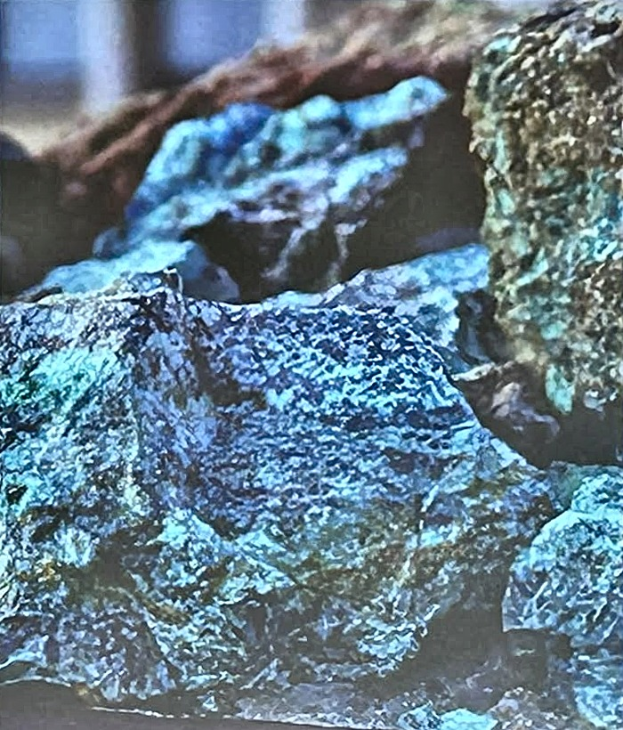
SECTION 1 / 5 · CONTEXT
Cobalt
63% of the Cobalt extracted worldwide comes from the Democratic Republic of Congo
The extraction is associated with environmental and social problems
The EU imports 81% of its Cobalt needs
BUT

Slide 9
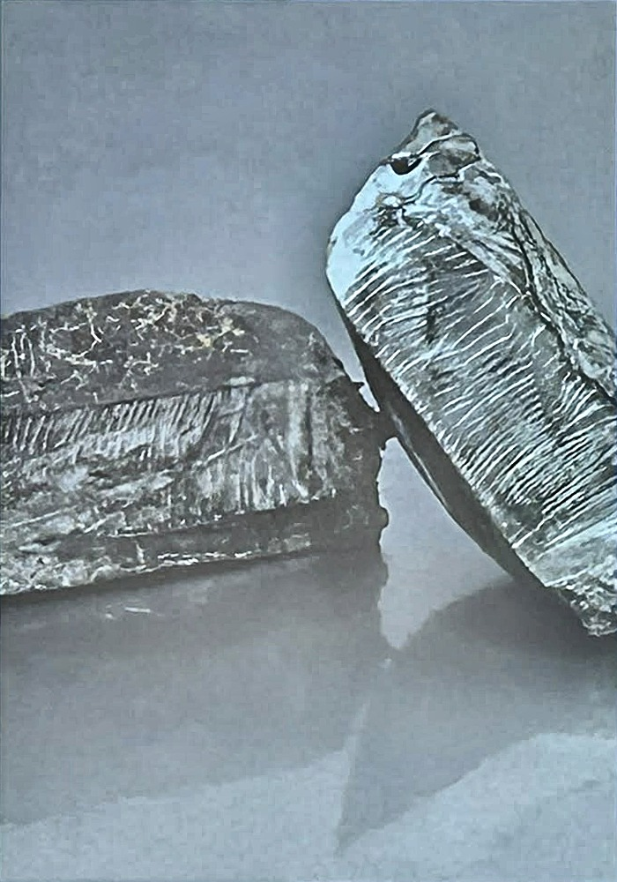
SECTION 1 / 5 · CONTEXT
Lithium
The EU imports 100% of its processed Lithium needs
Of these processed imports, 79% come from Chile
Extremely concentrated imports
Extracting new Lithium is 3 to 5 times cheaper than recycling it

Slide 10
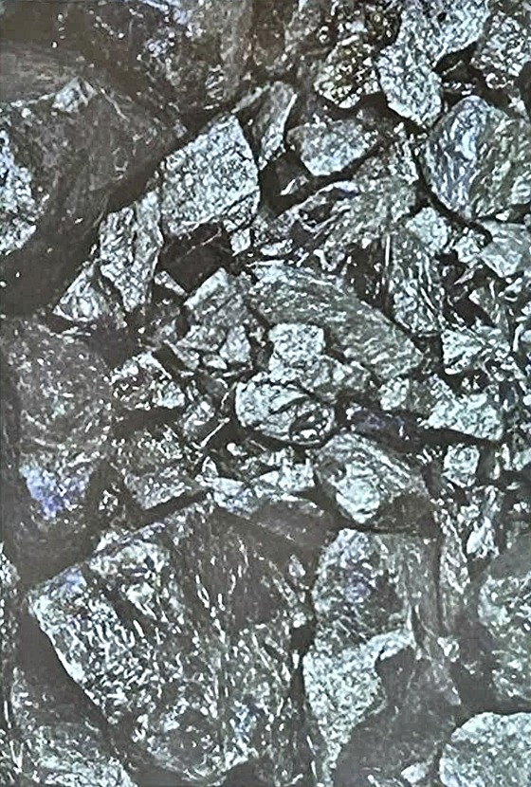
SECTION 1 / 5 · CONTEXT
Nickel
The EU imports 75% of its processed Nickel needs
Of these processed imports, 29% come from Russia, 17% from Finland, 10% from Norway
The supply is more diversified and the connected risk is lower

Slide 11
SECTION 1 / 5 · CONTEXT
Batteries
As of today there are three major battery chemistries that are used to power electric vehicles:
Nickel Cobalt Aluminium (NCA)
Usually used by Tesla.
High energy density and cost
Nickel Manganese Cobalt (NMC)
comes in varying ratios (e.g., NMC 111, 532, 622, 811). High energy density and modularity that allows to lower cost
Lithium Iron Phosphate (LFP)
cobalt-free and nickel-free. Increasingly popular because of its cheaper price and long life

Slide 12
SECTION 1 / 5 · CONTEXT
BATTERY SALES IN THE EU IN 2023
In 2025, LFP climbed above 12% marketshare

Slide 13
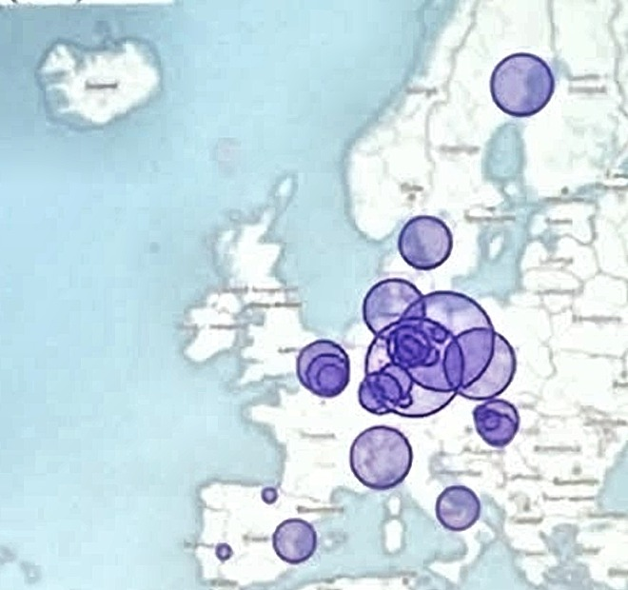
SECTION 2 / 5 · INDUSTRY & POLICY
PRODUCTION CAPACITY
To address the surge in EV sales, the EU’s battery production capacity is expected to surge from 292 GWh in 2024 to 1024 GWh by 2030.
Germany is set to lead with 474 GWh of production capacity by 2030, followed by Poland and France.
Year: 2030
Total Capacity (GWh): 1024

Slide 14
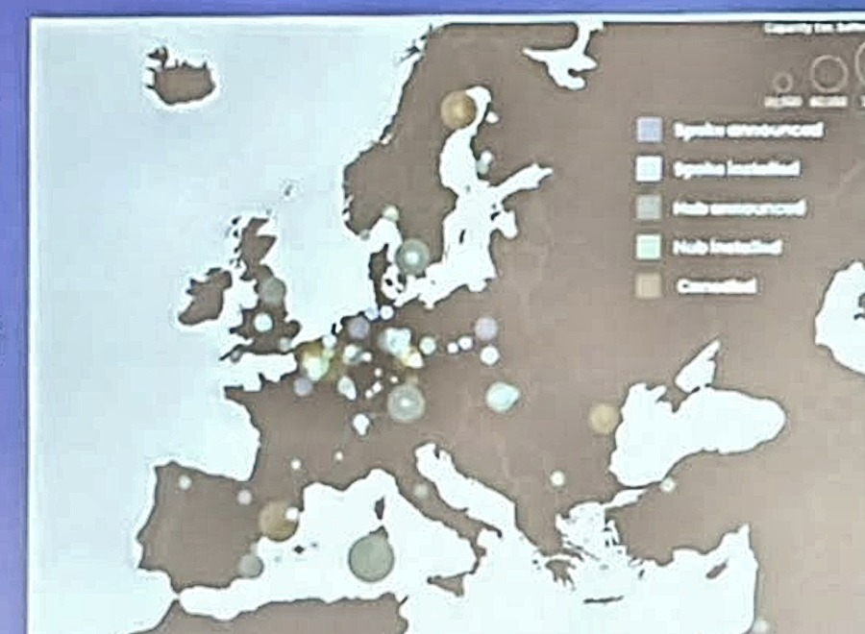
SECTION 2 / 5 · INDUSTRY & POLICY
RECYCLING CAPACITY
The Fraunhofer Institute reported on the main Lithium-ion recycling facilities in Europe.
Spokes: perform the first steps of battery recycling
Hubs: can also recover the valuable materials
Source: Fraunhofer (2025)

Slide 15
SECTION 2 / 5 · INDUSTRY & POLICY
RECYCLING CAPACITY
There is a structural overcapacity of the recycling infrastructure in Europe due to:
Slower Battery Production Ramp-Up
Anticipation of Future Demand (2030 onwards)
Source: Fraunhofer (2025)

Slide 16





SECTION 2 / 5 · INDUSTRY & POLICY
LIB RECYCLING DRIVERS
Environmental Sustainability
Resource Efficiency and Circular Economy
Economic Incentives
Supply Chain Security
Economic and Social Impacts

Slide 17
SECTION 2 / 5 · INDUSTRY & POLICY
EU LEGISLATION
Li: 6%
Co: 16%
Ni: 6%
Li: 12%
Co: 26%
Ni: 15%
Recycling contents:
% of recycled materials that are used to manufacture new batteries
2027
2031
2036
Recycling targets:
% of materials that enter recycling that are recovered
Li: 50%
Co: 90%
Ni: 90%
Li: 80%
Co: 95%
Ni: 95%
Notes:
Regulation (EU) 2023/1542 on batteries: minimum recycled content (2031, 2036) and material recovery targets (2027, 2031).

Slide 18





SECTION 3 / 5 · CIRCULAR STRATEGIES
CIRCULAR SUPPLY CHAIN
Raw Material Extraction
Battery Production
Vehicle Assembly
User
Collection Center
Flow of Raw
Materials
Flow of
Batteries
Recycling

Slide 19


SECTION 3 / 5 · CIRCULAR STRATEGIES
CIRCULAR STRATEGIES
Recycling is the final step, but not the only option: before it, a battery’s useful life can be extended. Two main strategies can contribute to this goal:
Remanufacturing
Repurposing

Slide 20


SECTION 3 / 5 · CIRCULAR STRATEGIES
REMANUFACTURING
Remanufacturing reconditions a pack that failed early and reinstalls it as a replacement (spare) part, returning it to the on-road fleet.
Sources: Huster et al. (2022); Kastanaki & Giannis (2023)

Slide 21



SECTION 3 / 5 · CIRCULAR STRATEGIES
CIRCULAR SUPPLY CHAIN
Raw Material Extraction
Battery Production
Vehicle Assembly
User
Remanufacturing
Other Sector
Collection Center
Flow of Raw
Materials
Repurposing
Flow of
Batteries
Recycling

Slide 22

SECTION 3 / 5 · CIRCULAR STRATEGIES
BATTERY PASSPORT
A passport for large electric vehicle (EV) and industrial (>2 kWh) batteries sold in the EU will be mandatory by the 18th February 2027, maintained by the producer.
This tool can help break down information silos among supply chain actors, improve traceability and support recycling and reuse processes.
scan me

Slide 23





SECTION 4 / 5 · RESEARCH & METHODS
RESEARCH OBJECTIVES
The main objectives of this research are:
Battery Flows
Circular Economy
Recycling
Model EU-27 passenger-car battery stocks and flows by chemistry, age and life stage, 2010–2050.
Assess how remanufacturing, repurposing and recycling reshape end-of-life flows.
Compare secondary supply with primary demand for 9 materials across 3 chemistry scenarios.

Slide 24

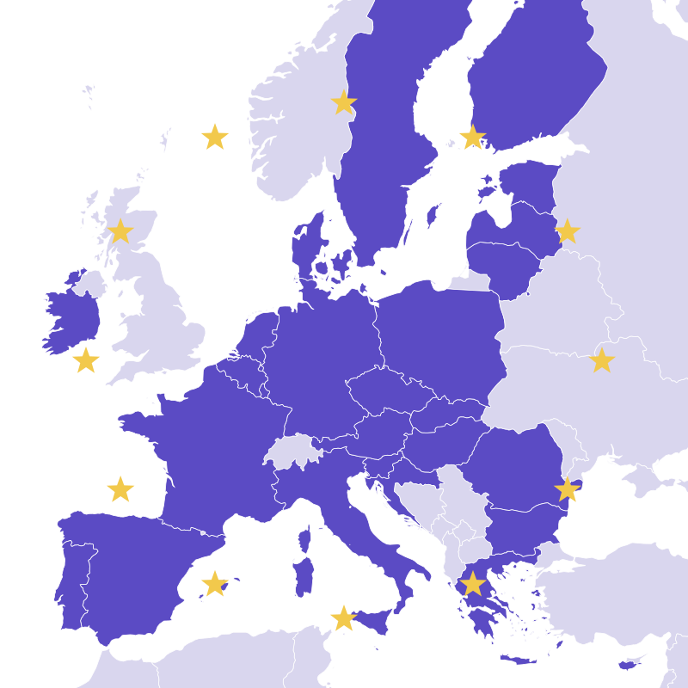

SECTION 4 / 5 · RESEARCH & METHODS
Methodology
1 - System Boundaries
2 - Input Parameters
3 - Scenarios and uncertainty
Geographic
Temporal:
2010–2050
Material
9 elements
10 chemistries
Historical EV Sales
Battery Chemistry Mix
Battery Capacity
CRM per chemistry
Circular Strategies
Three scenarios: Baseline, LFP, Next-Gen
Sensitivity screening
Monte Carlo analysis
4 - Lifespan Analysis
5 - Battery Flows
6 - Results
Remanufacturing
Repurposing
Recycling
Notes:
Box 6: grafico illustrativo ricostruito dalla forma della slide originale, non contiene i risultati reali del modello.

Slide 25
SECTION 4 / 5 · RESEARCH & METHODS
SCENARIO DEFINITION
Sales trajectory
Calibrated to Eurostat history and IEA outlooks.
Modelled BEV registrations reach 1.89 million in 2025 (17.3% of new cars). Sales are an estimate based on market projections, reflecting the flexibility introduced after 2035.
Sources: Eurostat (2026a, 2026b); IEA (2026); ACEA (2026)
Notes:
Valori del grafico ricostruiti dalla foto (BEV 2025 = 1,89 M dal testo, totale ~10 M nel 2050): sostituire con i dati del modello.

Slide 26
SECTION 4 / 5 · RESEARCH & METHODS
METHODOLOGICAL FRAMEWORK
dMFA Cohort Model (2010–2050)
Weibull lifespan α, λ
EV Sales
φ, σ
Remanufacture
k = 2
Collection c
Routing
A, R
EV Battery Production
f, W
First Life
k = 1
Recycle
η
Battery Chemistries
Market Shares χ
Repurpose
k = 3
Recovered Materials
Production Scrap
recovered at η waste
Material Layer
Chemistry Layer
Vehicle Layer
Stage Layer
Co
Al
Li
Cu
Ni
NCA
NMC111
NMC532
NMC622
NMC811
BEVs
PHEVs
First Life
Remanufacture
Mn
P
Graphite
Si
NMC955
LFP
Li-Air
Li-S
Repurpose
Recycle
Notes:
Figure 1 - Methodological framework of the EU-27 dynamic material flow analysis. Exogenous EV sales (phi, sigma) and chemistry shares (chi) drive new pack demand at battery production, where pack mass (W) and material fractions (f) set composition. The cohort model assigns lifespans via a Weibull distribution with chemistry- and vintage-specific scale lambda. Stage-exit packs pass a collection gate (c_k) and age-eligibility (A_max) and routing gates (R) before remanufacturing (stage 2), repurposing (stage 3) or recycling (recovery efficiency eta); production scrap is recovered at eta_waste.

Slide 27



SECTION 4 / 5 · RESEARCH & METHODS
SCENARIO DEFINITION
Baseline
NMC955 and NMC811 take 70% of new sales by 2050; LFP keeps a stable minority share (20%)
THREE CHEMISTRY SCENARIOS
Scenario B: LFP
LFP rises to 60% of new sales by 2050; NMC811 and NMC955 fall to 15% each
Scenario C: Next-Generation
Li-Air and Li-S enter in 2031 and reach 75% of new sales by 2050

Slide 28


BONUS · EASTER EGG
MEANWHILE, IN THE AUDIENCE…
Field observation n° 1
Peak concentration recorded during the dMFA cohort model explanation.
Sample size: n = 2
Confidence level: very high
Supporting literature: Operations and Process Management (on the desk)
certified Supply Chain enjoyers

Slide 29
SECTION 4 / 5 · RESEARCH & METHODS
SCENARIO DEFINITION
The three scenarios share the same sales trajectory, EV size mix, collection rate (95% from 2035), age-eligibility fractions, routing shares and first-life lifespans.
They differ only in the chemistry market-share trajectory, so the influence of battery chemistry is separated from the circularity settings.

Slide 30


SECTION 4 / 5 · RESEARCH & METHODS
BATTERY LIFESPAN ESTIMATION
Stage exit follows a Weibull distribution: shape α = 3.5, scale λ specific to chemistry and build vintage
Average first life: about 6 years for the earliest cohorts, rising to 10 years by 2050 (12 for LFP)
Conditional annual exit probability

Slide 31

SECTION 5 / 5 · RESULTS & CONCLUSION
RESULTS
In the deterministic central case, remanufacturing is bounded by its narrow eligibility window: about 170 thousand packs per year by 2050 in the Baseline and 188 thousand in the LFP scenario.
Repurposing for second life is the larger circular route: an inflow of 3.36 million packs per year in the Baseline, 3.51 million in LFP and 3.31 million in Next-Gen by 2050, building a stationary storage stock of 20.8 million (Baseline) to 21.7 million packs (LFP).
2nd

Slide 32
SECTION 5 / 5 · RESULTS & CONCLUSION
RESULTS
Growth: End-of-life battery packs entering recycling rise from ~1.06M/year in 2030 to 3.7M in 2040 and 6.6M in 2050.
Chemistry mix varies by scenario:
Baseline: NMC955 and NMC811 dominate with 63% of recycled packs.
LFP scenario: LFP shares grow from 16% of the stream in 2028 to 37%.
Next-Generation: Li-S and Li-Air surge from just 1% in 2036 to a combined 49%.
Notes:
Grafici ricostruiti: totali (1,06 M nel 2030, 3,7 M nel 2040, 6,6 M nel 2050) e quote citate nel testo sono rispettati; le traiettorie intermedie delle singole chimiche sono interpolate e vanno sostituite con l'output del modello.

